Slide 1
Memory Management Session 10
Course : COMP6153
Effective Period : September 2018

Slide 2
Sub Topics
Memory management requirements
Addressing
Memory Management Implementation
Memory Allocation Algorithm

Slide 3
These slides have been adapted from: Stallings, W. (2011). Operating Systems: Internals and Design Principles. 8^{th.} ISBN: 978-0-13-380591-8 Chapter 7
Acknowledgement

Slide 4
Learning Objectives
At the end of this lecture, students are able to:
LO2 : Explain how Memory Management is implemented in Modern Operating System
LO3 : Apply different strategies of Memory Allocation Methods

Slide 5
Memory Management
Subdividing memory to accommodate multiple processes
Memory needs to be allocated efficiently to pack as many processes into memory as possible

Slide 6
Memory Management Requirements(1)
Relocation
Programmer does not know where the program will be placed in memory when it is executed
While the program is executing, it may be swapped to disk and returned to main memory at a different location (relocated)
Memory references must be translated in the code to actual physical memory address

Slide 7
Memory Management Requirements(2)
Protection
Processes should not be able to reference memory locations in another process without permission
Impossible to check absolute addresses in programs since the program could be relocated
Must be checked during execution
Operating system cannot anticipate all of the memory references a program will make

Slide 8
Memory Management Requirements(3)
Sharing
Allow several processes to access the same portion of memory
Better to allow each process (person) access to the same copy of the program rather than have their own separate copy

Slide 9
Memory Management Requirements(4)
Logical Organization
Programs are written in modules
Modules can be written and compiled independently
Different degrees of protection given to modules (read-only, execute-only)
Share modules

Slide 10
Memory Management Requirements(5)
Physical Organization
Memory available for a program plus its data may be insufficient
Overlaying allows various modules to be assigned the same region of memory
Programmer does not know how much space will be available

Slide 11
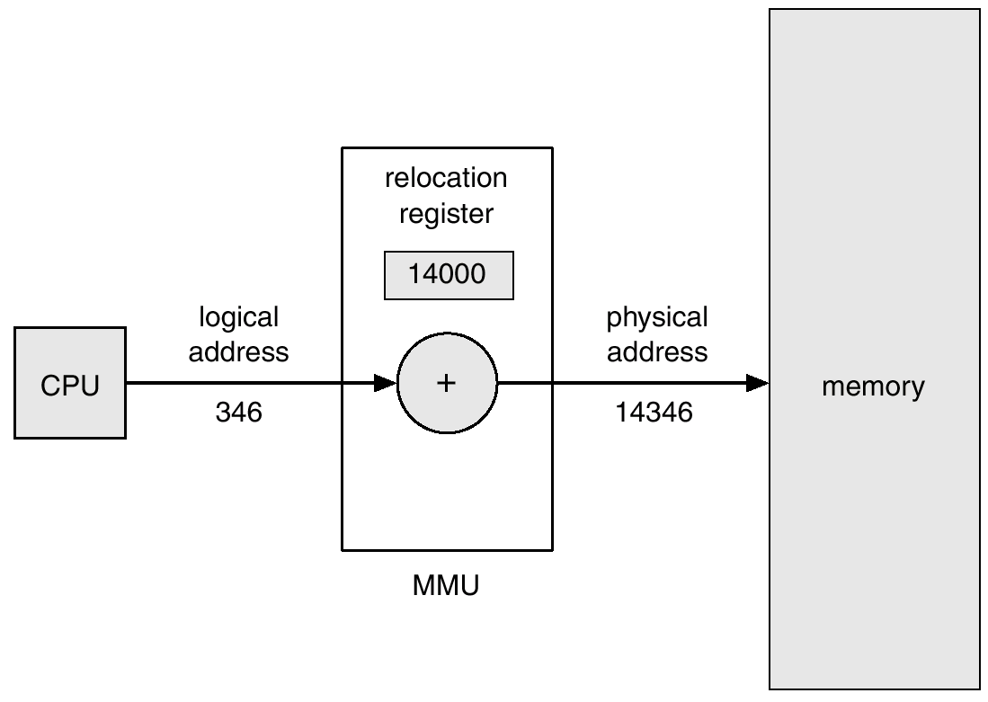
Relocation

Slide 12
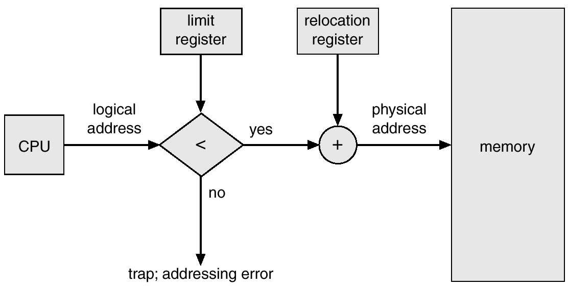
Protection

Slide 13
Addressing
Logical
reference to a memory location independent of the current assignment of data to memory
translation must be made to the physical address
Relative
address expressed as a location relative to some known point
Physical
the absolute address or actual location in main memory

Slide 14
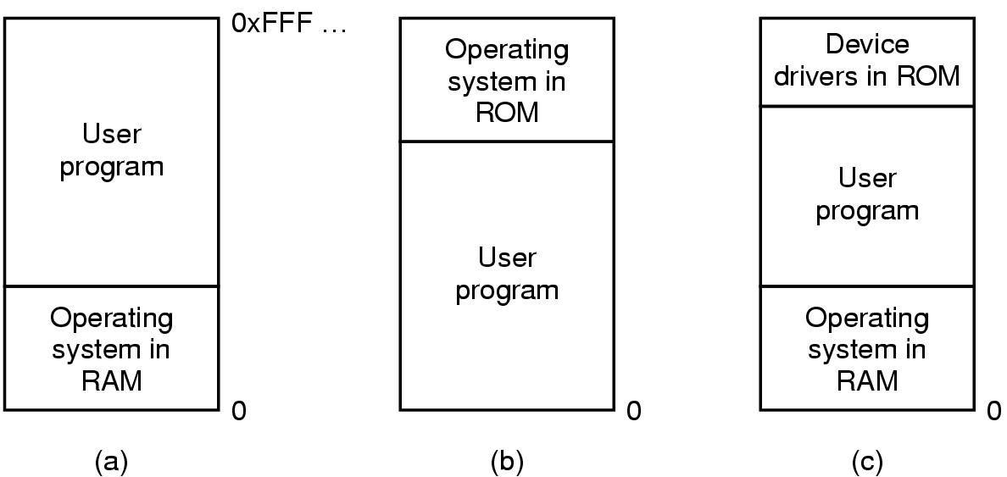
Monoprogramming without swapping
Three simple ways of organizing memory
- an operating system with one user process

Slide 15
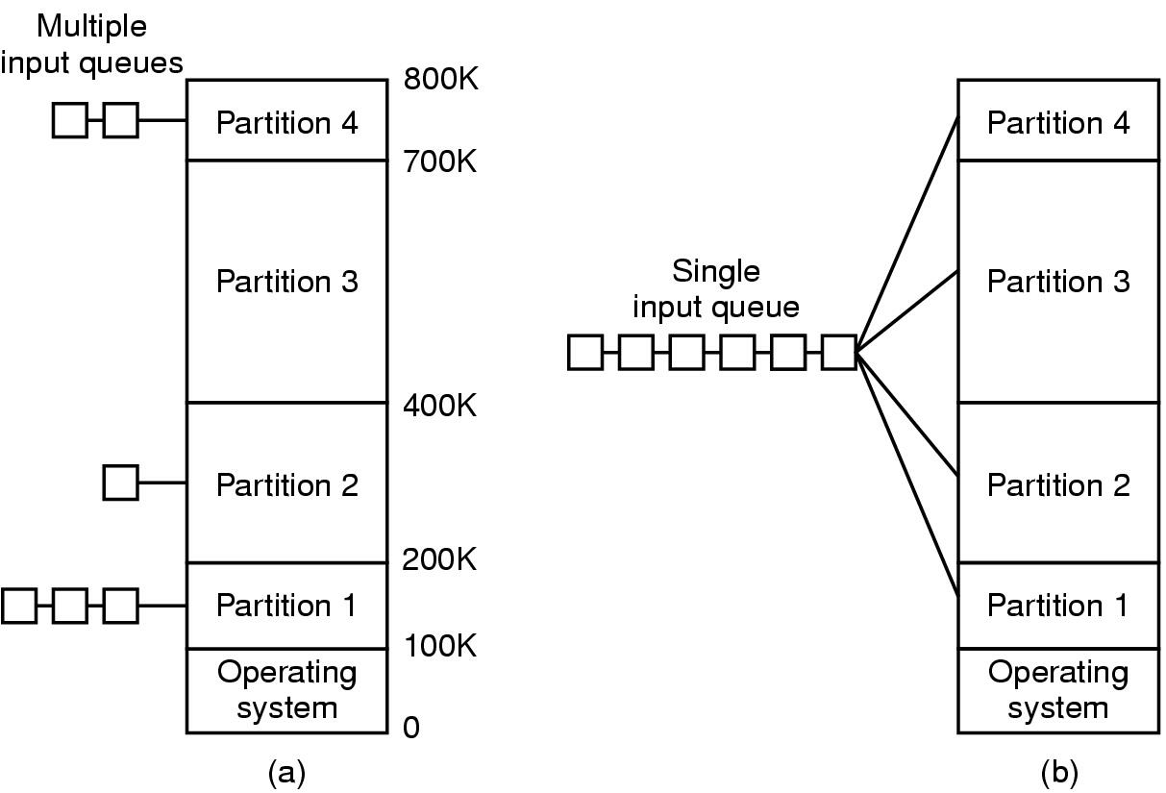
Multiprogramming with fixed partition(1)
Fixed memory partitions
separate input queues for each partition
single input queue

Slide 16
Multiprogramming with fixed partition(2)
Multiple input queue
When a job arrives, it can be put into the input queue for the smallest partition large enough to hold it
Any space in a partition not used by a job is lost
The queue for a large partition is empty but the queue for a small partition is full
Single input queue
Whenever a partition becomes free, the job closest to the front of the queue that fits in it could be loaded
May waste a large partition on a small job
Alternatively → search the whole input queue whenever a partition becomes free and pick the largest job that fits
Discriminates against small jobs, whereas the smallest job shall get the best service
Solution:
Have at least small partition around
A job may not be skipped for k times

Slide 17
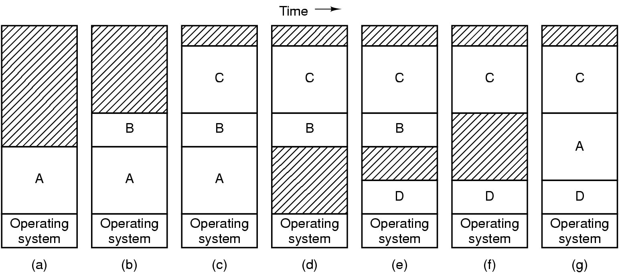
Swapping (1)
Memory allocation changes as
processes come into memory
leave memory
Shaded regions are unused memory

Slide 18
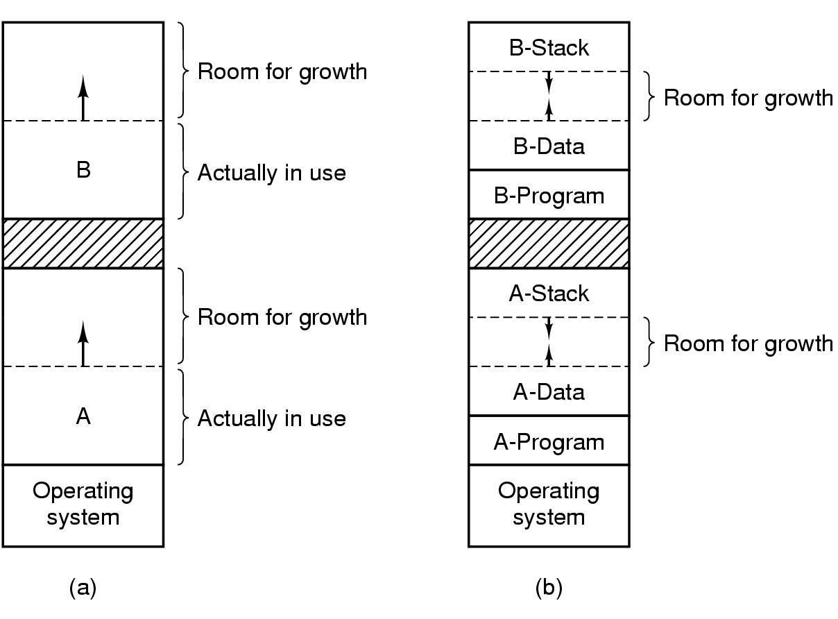
Swapping (2)
Allocating space for growing data segment
Allocating space for growing stack & data segment

Slide 19
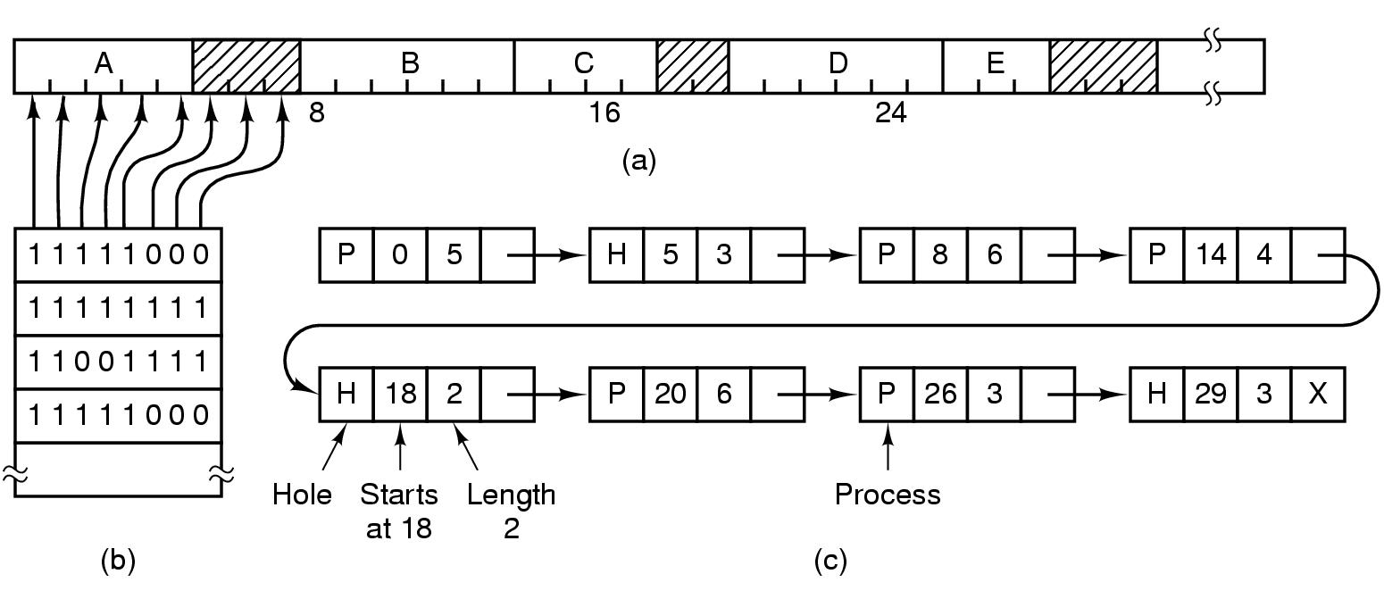
Memory Management with bit map
Part of memory with 5 processes, 3 holes
tick marks show allocation units
shaded regions are free
Corresponding bit map
Same information as a list

Slide 20
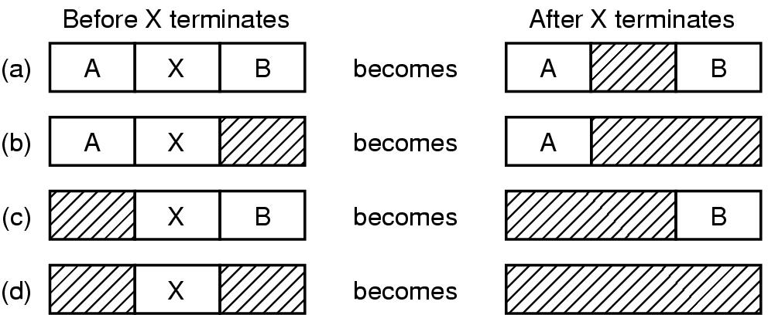
Memory Management with linked list

Slide 21
Memory Partitioning
Fixed Partitioning
Dynamic Partitioning
Simple Paging
Simple Segmentation
Virtual Memory Paging
Virtual Memory Segmentation

Slide 22
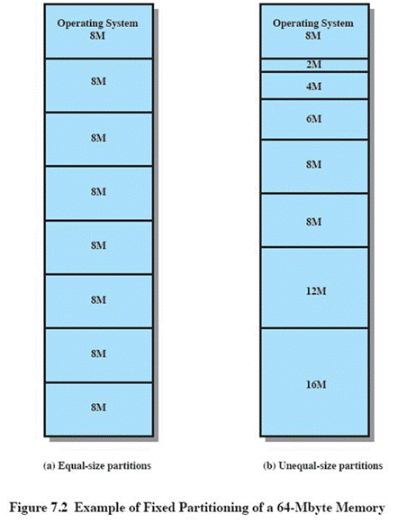
Fixed Partitioning
Equal-size partitions (see fig 7.3a)
Any process whose size is less than or equal to the partition size can be loaded into an available partition
The operating system can swap a process out of a partition
If none are in a ready or running state

Slide 23
Fixed Partitioning Problems
A program may not fit in a partition.
The programmer must design the program with overlays
Main memory use is inefficient.
Any program, no matter how small, occupies an entire partition.
This results in internal fragmentation.

Slide 24
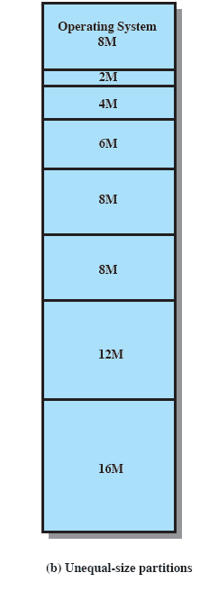
Solution - Unequal Size Partition
Programs up to 16M can be accommodated without overlay
Smaller programs can be placed in smaller partitions, reducing internal fragmentation

Slide 25
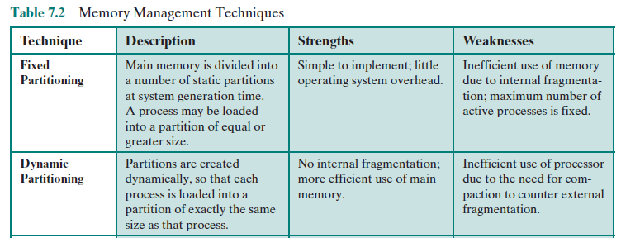
Memory Partitioning
Fixed vs Dynamic partitioning

Slide 26
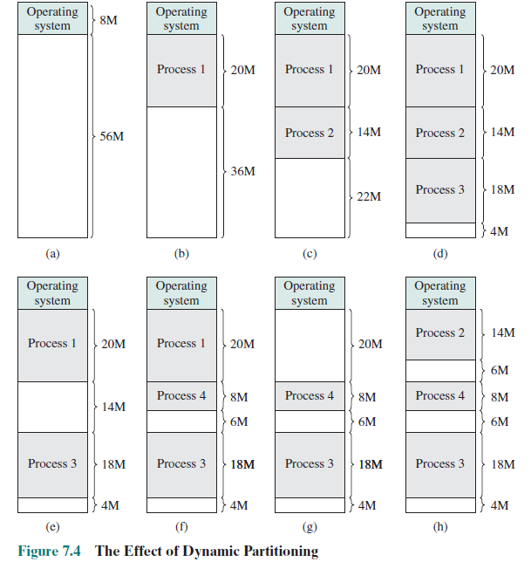
Example of dynamic partitioning

Slide 27
Dynamic partitioning
Partitions are of variable length and number
Process is allocated exactly as much memory as required

Slide 28
Dynamic partitioning Example
OS (8M)
P1
(20M)
External Fragmentation
Memory external to all processes is fragmented
Can resolve using compaction
OS moves processes so that they are contiguous
Time consuming and wastes CPU time
Empty (6M)
P2
(14M)
Empty (56M)
P4(8M)
Empty (6M)
P3
(18M)

Slide 29
Placement Algorithm (Memory allocation algorithm)
When it is time to load or swap a process into main memory, and if there
is more than one free block of memory of sufficient size, then the operating system
must decide which free block to allocate.

Slide 30
Placement Algorithm (Memory allocation algorithm)
First Fit
Next Fit
Best Fit
Worst Fit
Quick Fit
Buddy System
To speed-up search:
Separate table for process and holes
Hole list is sorted (eg ascending)
⇒ Best fit = first fit; next fit is unnecessary

Slide 31
Best Fit
Operating system must decide which free block to allocate to a process
Best-fit algorithm
Chooses the block that is closest in size to the request
Worst performer overall
Since smallest block is found for process, the smallest amount of fragmentation is left
Memory compaction must be done more often

Slide 32
First Fit
First-fit algorithm
Scans memory form the beginning and chooses the first available block that is large enough
Fastest
May have many process loaded in the front end of memory that must be searched over when trying to find a free block

Slide 33
Next Fit
Next-fit
Scans memory from the location of the last placement
More often allocate a block of memory at the end of memory where the largest block is found
The largest block of memory is broken up into smaller blocks
Compaction is required to obtain a large block at the end of memory

Slide 34
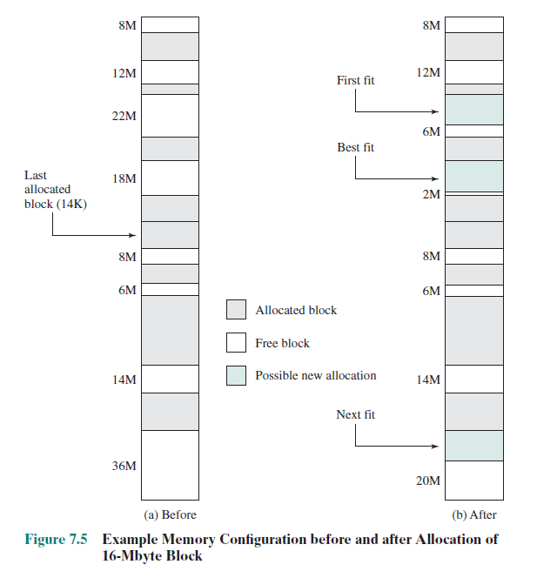
Example

Slide 35
Buddy System
Buddy System
Entire space available is treated as a single block of 2^{U}
If a request of size s such that 2^{U-1} < s <= 2^{U}, entire block is allocated
Otherwise block is split into two equal buddies
Process continues until smallest block greater than or equal to s is generated

Slide 36
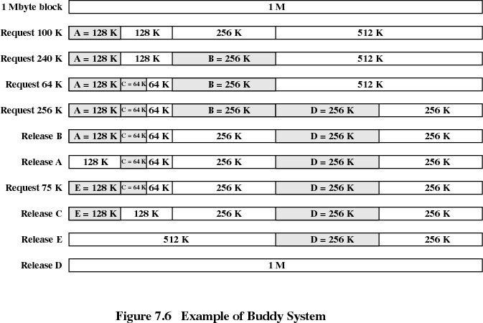
Buddy System(2)

Slide 37
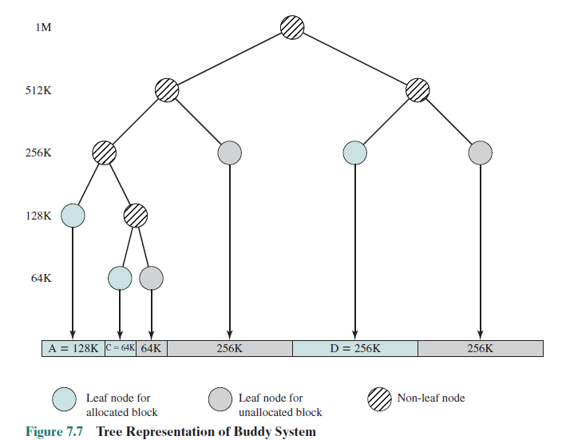
3Buddy System(2)
Tree representation

Slide 38
References
Stallings, W. (2014). Operating Systems: Internals and Design Principles. 8^{th.} ISBN: 978-0-13-380591-8

